Slide 1
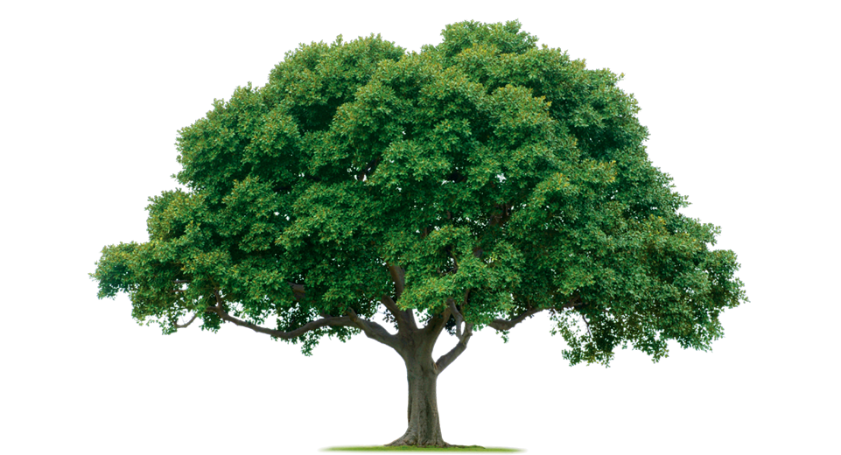
Leaves 3.4

Slide 2
What is a plant?

Slide 3
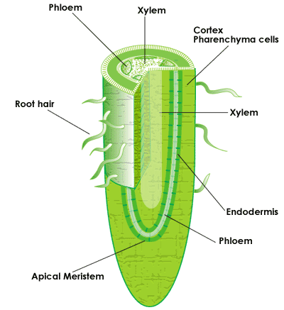
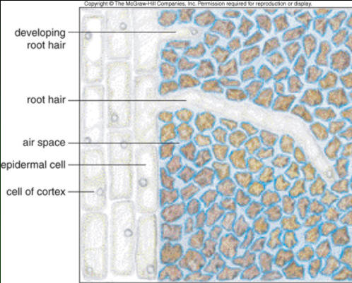
Anatomy of the root

Slide 4
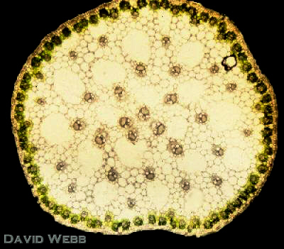
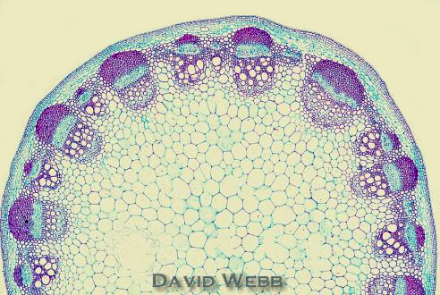
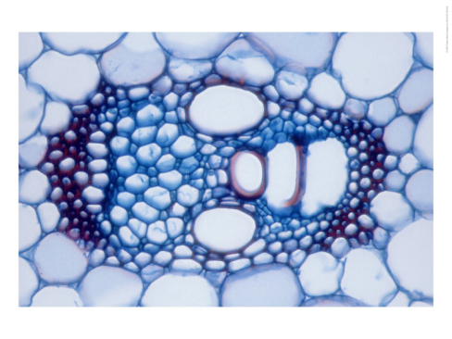
Vascular system stem

Slide 5
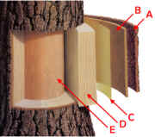
Vascular system tree trunk
A outer bark
B inner bark
C cambium cell layer
D Sapwood
E Heartwood
phloem

Slide 6
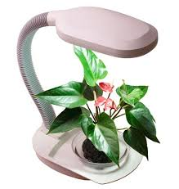
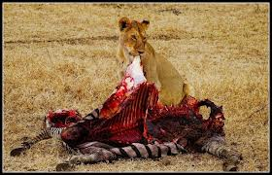
Autotroph and heterotroph
Autotroph
Makes it own energy
Heterotroph
Eats other organisms to get its energy.

Slide 7
Plant cells
Photosynthesis a chemical reaction that takes place in the chloroplasts.

Slide 8
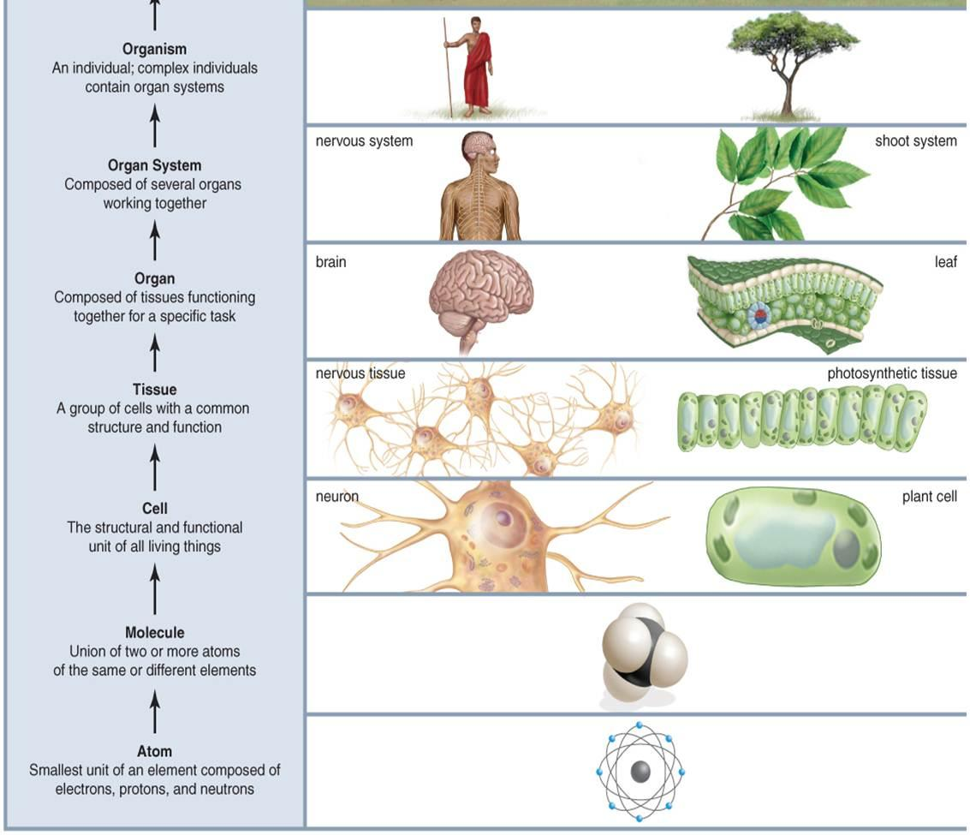
Levels of organisation

Slide 9
Your first chemistry lesson
Atoms
The smallest units where everything (living and dead) is made of.
For example
H = Hydrogen (Waterstof)
O = Oxygen (Zuurstof)
C = carbon (Koolstof)
Molecules
Are made of 2 or more atoms.
For example
H₂O = Water
CO₂ = Carbondioxide (Koolstofdioxide)
O₂ = Oxygen (Zuurstof)
C₆H₁₂O₆ = Glucose

Slide 10
Photosynthesis
A chemical reaction (activated by light) in which the plant creates glucose and oxygen.
Water+ carbondioxide + light = glucose + oxygen
H₂O + CO₂ + energy = C₆H₁₂O₆ + O₂

Slide 11
Anatomy leaf

Slide 12
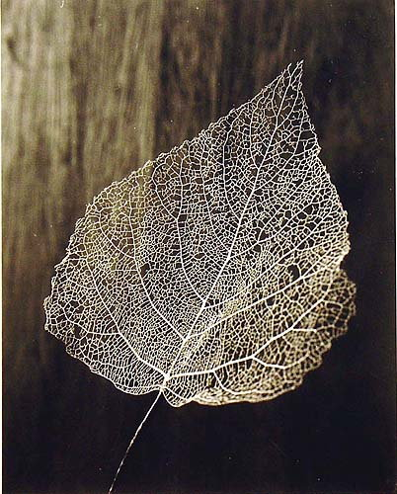
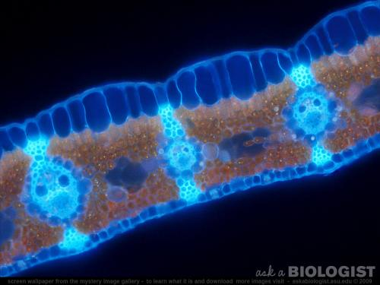
Vessels in a leaf

Slide 13
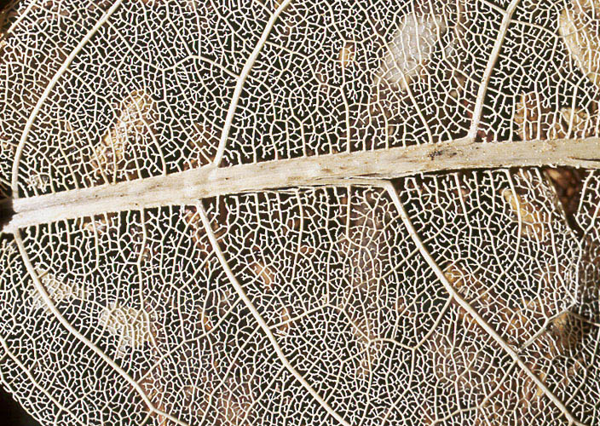

Slide 14
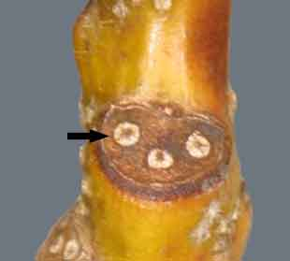
Leaf scar
The place where the leaf was attached is now sealed of by a corky layer.
The arrow points to the vascular bundles

Slide 15
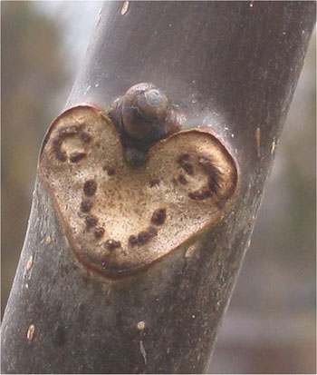

Slide 16
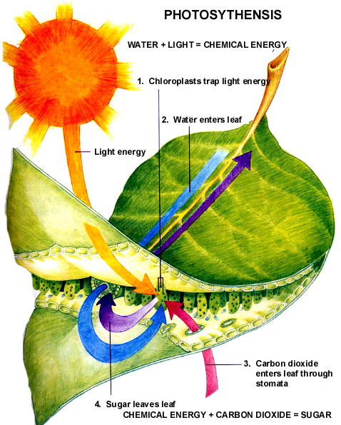
Function of leaves
Photosynthesis

Slide 17
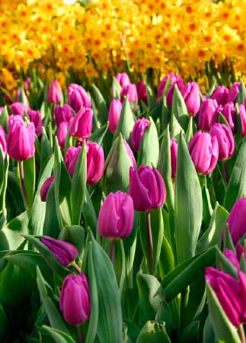
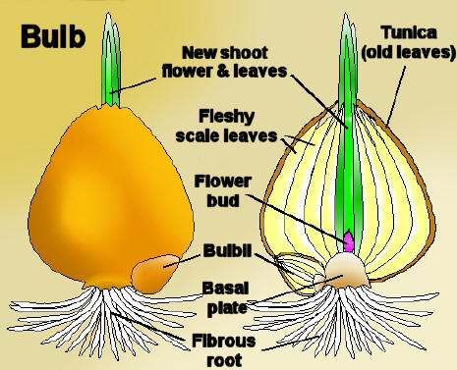

Slide 18
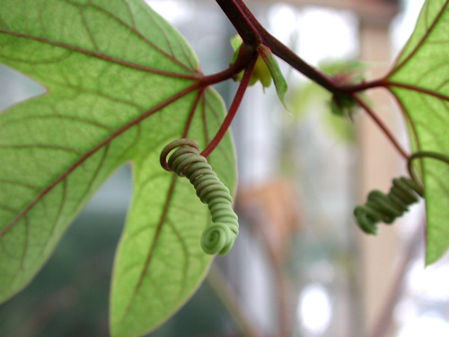
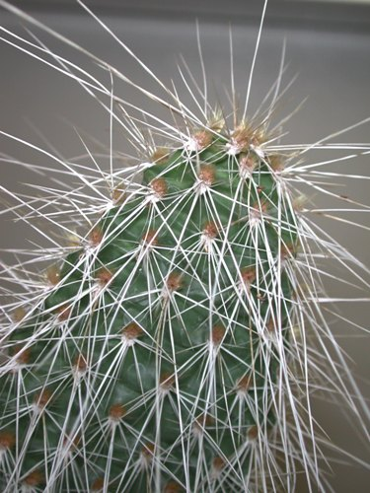
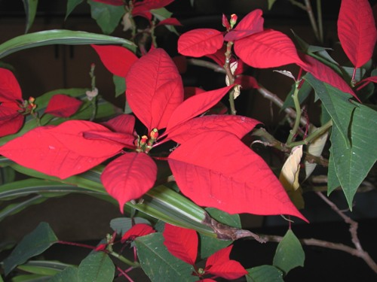

Slide 19
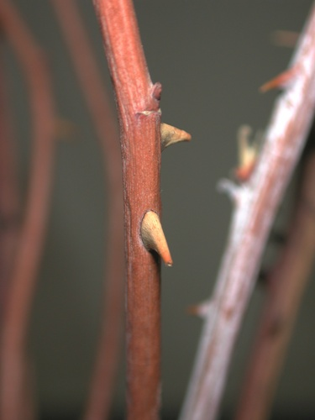
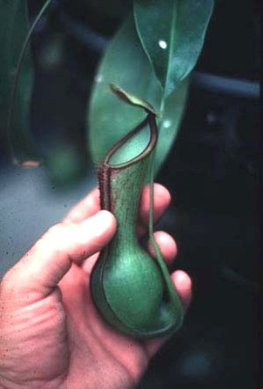
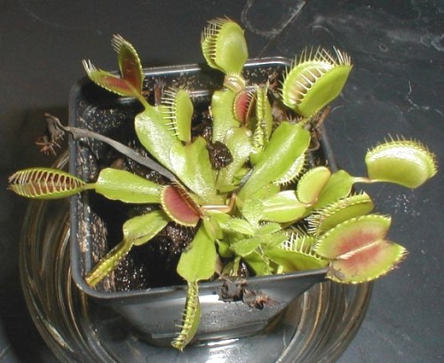

Slide 20
Function of leaves
Photosynthesis
Photo = light
Synthesis = assemble, put together
What is put together?

Slide 21
Function of leaves
Photosynthesis
What is put together?
Glucose and oxygen are created out of water and carbon dioxide (a gas):
Water + CO2 → glucose + oxygen

Slide 22
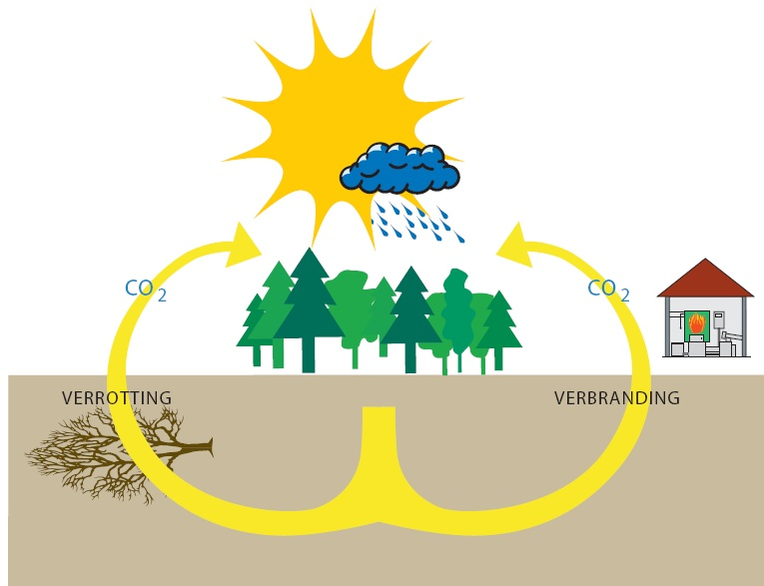
Photosynthesis VS respiration
C₆H₁₂O₆ + O₂ = H₂O + CO₂ + energy
H₂O + CO₂ + energy = C₆H₁₂O₆ + O₂

Slide 23
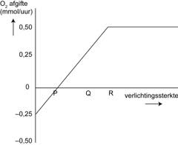
Bruto and netto production.
Bruto production=
How much O² is produced.
Netto production=
Bruto production – the amount O² used.
Vragen:
Wanneer is de bruto productie 0?
Wanneer is de netto productie 0?
Waarom stopt de stijging bij R?
Wat als je de plant mest geeft?

Slide 25
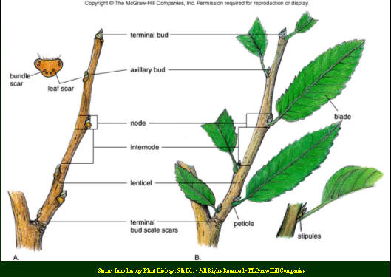

Slide 26
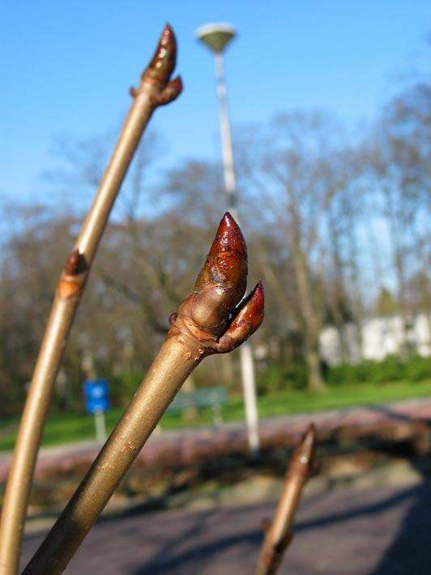

Slide 27
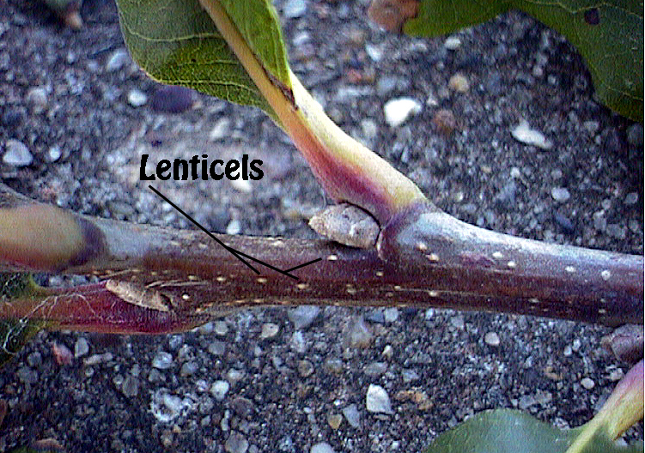

Slide 28
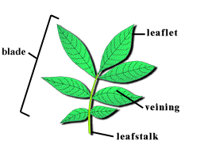

Slide 29
